Slide 1

NeoSpend:
Expense Management
Platform with
Analytics Dashboard
Secure, Scalable, and Insightful Expense Tracking

Slide 2

The Challenge
Manual Tracking
Legacy Solutions
Tedious, error-prone processes lacking real-time insights
Poor user support, weak security, outdated analytics
User Needs
Privacy-focused expense management with actionable insights
Users demand secure, scalable financial control with modern analytics

Slide 3

Meet NeoSpend
Secure User Authentication
AWS Cognito powers robust user isolation
Real-Time Analytics
Interactive visualisations with Chart.js
Smart Budget Alerts
Proactive notifications and downloadable expenses and reports
Modern Responsive Design
Mobile-friendly interface for anywhere access

Slide 4
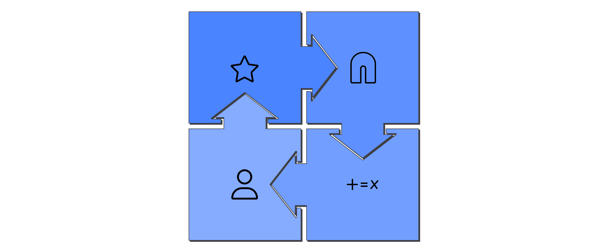




Cloud-Native Architecture
Next.js (Amplify)
API Gateway
Next.js app hosted on
AWS Amplify
API routes all frontend requests to
backend Lambda functions,
validates JWT tokens.
Lambda + DynamoDB
Cognito Auth
AWS Cognito User Pool and
Hosted UI for secure OAuth2 login
and JWT token issuance.
AWS Lambda functions
handle business logic.
DynamoDB tables store
all user data, partitioned
by user for privacy.

Slide 5





Technology Stack
Frontend Excellence
Next.js, Tailwind CSS, Chart.js for responsive UI and data visualization
Serverless Backend
AWS Lambda with Node.js, API Gateway HTTP API for secure routing
Data & Auth
DynamoDB NoSQL storage, AWS Cognito JWT authentication
CI/CD
AWS Amplify CI/CD, GitHub integration

Slide 6






User Journey
Access NeoSpend
Secure Login
Dashboard Display
User opens Amplify-hosted web app.
Cognito handles OAuth2 authentication.
API Gateway loads user-specific data.
Insights & Alerts
Manage Expenses
Real-time analytics and budget notifications.
CRUD operations update data in DynamoDB.

Slide 7

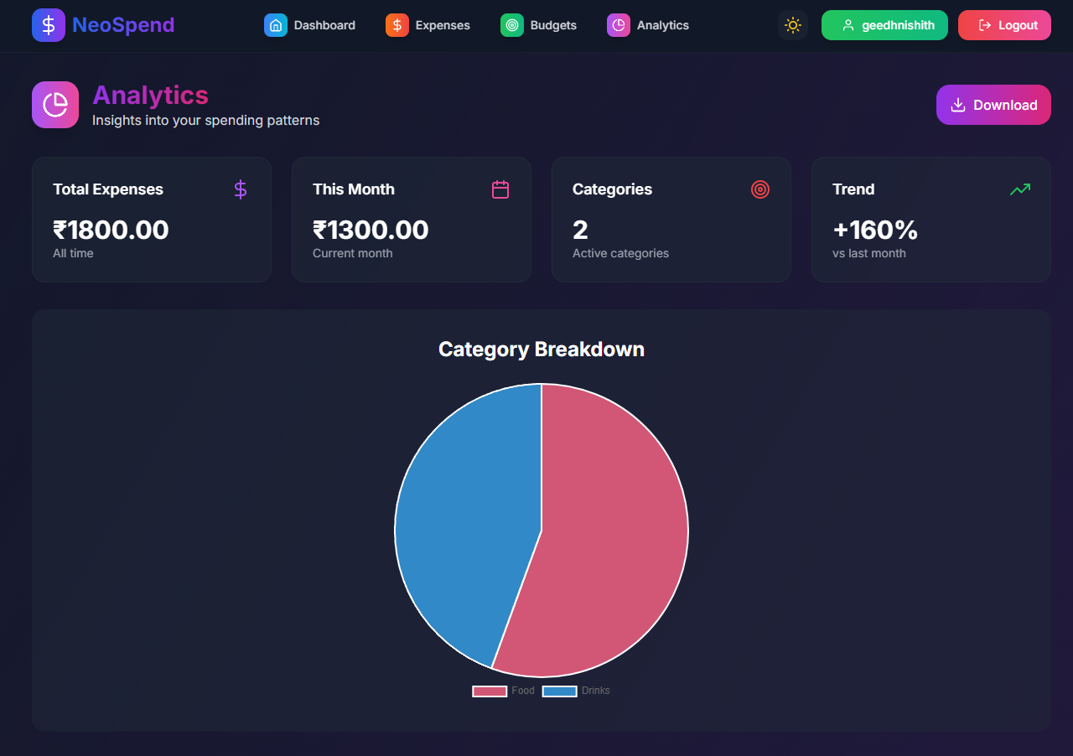
Feature Showcase
Interactive Dashboard
Quick stats, expense cards, budget progress
Advanced Filtering
Category dropdowns, date ranges, search
Real-Time Analytics
Daily, weekly, monthly spending trends
Alert System
Persistent notifications for budget thresholds

Slide 8

Cost, Security & Scalability
Service | Estimated Monthly Cost
Cognito | $0 (within free tier)
Amplify | $0–$3
Lambda | $0 (within free tier)
API Gateway | $0 (within free tier)
DynamoDB | $0–$2
S3 | $0–$1
CloudWatch | $0–$1
Total | $0–$8/month
Security First
Infinite Scale
AWS Cognito OAuth2 & JWT authentication
Serverless auto-scaling architecture
User data isolation per API call
Pay-per-use cost efficiency
API Gateway token validation
Zero direct database access

